Slide 1


COMPANY PROFILE
Manufacturers of fully automated F.F.S ,
B.F.S Machine & moulds .

Slide 2

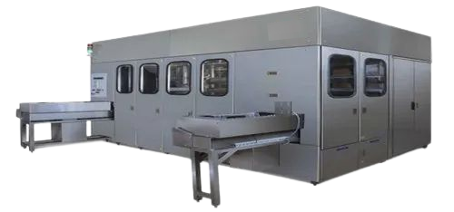





Table of Content
ABOUT COMPANY
VISION / MISSION
OUR TEAM
OUR SERVICE
CONTACT

Slide 3
About
Company
BVM Engineering Industries has rapidly established itself as a prominent player in the pharmaceutical machine manufacturing sector. Our cutting-edge form-fill-seal (FFS) technology is engineered to facilitate the seamless creation of distinctive plastic packaging for a wide array of valuable liquids. With a steadfast commitment to safety and cost-effectiveness, our FFS solutions ensure that every drop is filled securely and economically, meeting the stringent requirements of pharmaceutical packaging standards.
In addition to our state-of-the-art FFS technology, we take immense pride in offering an extensive range of ampoule filling machines that cater to diverse industry needs. These machines are meticulously designed and engineered to deliver unparalleled precision and efficiency in liquid filling processes, thereby enhancing productivity while upholding the highest quality standards.
At BVM Engineering Industries, we understand that gaining regulatory approvals and managing product lifecycles can be complex undertakings. Therefore, we offer comprehensive approval and lifecycle services aimed at guiding our clients through each stage of the process with expertise and proficiency. Our dedicated team is equipped with the knowledge and resources necessary to navigate regulatory requirements seamlessly, ensuring compliance while optimizing time-to-market strategies.
Moreover, our unwavering commitment extends beyond product delivery through our complete range of product support services. We stand ready to provide ongoing assistance tailored to your specific needs – from installation support to maintenance guidance – ensuring that your operations run smoothly without compromise.
By partnering with BVM Engineering Industries, you not only gain access to innovative solutions but also experience unwavering dedication towards delivering safe, efficient, and high-quality pharmaceutical packaging and filling processes. We are committed to propelling your success by providing advanced technologies coupled with unparalleled support services designed for sustainable growth within the pharmaceutical industry.

Slide 4

Mission
Our goal is to create and manufacture advanced machines that help industries reach their maximum capability. We are committed to delivering precise engineering and creative solutions, so that our clients receive top-notch products that fulfill their operational requirements.
Our Value
Vision
We aspire to be a top leader in the manufacturing of Parenteral machines, known for our dedication to producing high-quality products, advancing technology, and ensuring customer satisfaction. Our goal is to constantly innovate and set new standards in machine design and manufacturing, making a significant impact on global industries through our products and services.

Slide 5
Milestones
2022
2023
2024
We are delighted to report the successful installation of the 500 ML Auto Deflesher machine in 2022.
We are delighted to announce the inauguration of our state-of-the-art advanced machine manufacturing unit in Baddi. This new facility represents a significant milestone for our company, signifying our commitment to technological advancement and expansion. With this strategic addition, we look forward to further enhancing our production capabilities and meeting the growing demands of our discerning clientele. We are confident that this new venture will bolster our position as a leading provider of cutting-edge machinery and contribute to the continued success of our esteemed customers.
We are proud to announce the successful installation of our first F.F.S. machine under the BVM Engineering Industries brand in 2024. This accomplishment highlights our dedication to innovation and quality, marking a significant milestone in our ongoing efforts to enhance operational efficiency and technological advancement.

Slide 6

Our Team
RAHUL SINGH
Rajib panda
Littu bahera
PRASHANJEET MANDAL
CHIEF ENGINEER
PROP.
&
COMMERCIAL
Manufacturing
assembling
CHIEF DESIGNER
D. MECH
EXP. – 9 YEARS
B. TECH (ELECTRONICS)
EXP. – 25 YEARS
B. TECH
(MECHANICAL)
EXP. – 20 YEARS
D. MECH
EXP. – 15 YEARS

Slide 7
Our Team
RABINA
HARIOM CHAUHAN
AJAY YADAV
ANIL KUMAR
KARAN KUMAR
B . COM
ACCOUNTANT
EXP. 3 YEARS
D. MECH
SERVICE ENGG.
EXP. – 7 YEARS
ITI
SERVICE ENGINEER
EXP- 7 YEARS
ITI
SERVICE ENGINEER
EXP. – 10 YEARS
+2
ASSEMBLING
SUPERVISOR
EXP. – 5 YEARS
AJEET KUMAR
SUBHAM KUMAR
UDHAY KUMAR
VISHAL KUMAR
ABHISHEK KUMAR
B . TECH
TOOL ROOM
OPERATOR
EXP. – 2 YEARS
ITI
TOOL ROOM OPERATOR
EXP.- 5 YEARS
ITI
FITTER
EXP. – 8 YEARS
ITI
TOOL ROOM OPERATOR
EXP. – 3 YEARS
ITI
TOOL ROOM OPERATOR
EXP – 3 YEARS
KRISHU
RANJAN
NIRAJ KUMAR
UMASHANKAR
+2
TOOL ROOM
OPERATOR
+2
TOOL ROOM OPERATOR
ITI
TOOL ROOM OPERATOR
ITI
TOOL ROOM OPERATOR
AND COUNTING………………..

Slide 8
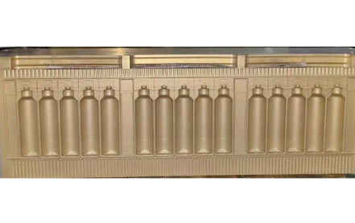
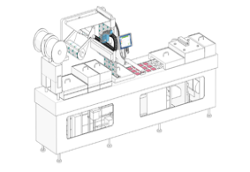
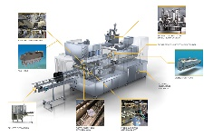
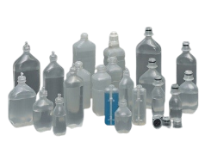
WHAT WE DO..
FULLY AUTOMATIC F.F.S MACHINE
FULLY AUTOMATIC B.F.S MACHINE
MOULDS
OTHER S.P.M
MACHINERY
We specialize in manufacturing a wide range of molds for F.F.S and B.F.S machines. Our cost-efficient and durable molds are designed to meet your specific needs, ensuring long-lasting performance. With our expertise, we provide high-quality solutions that optimize production processes and deliver exceptional value for your business requirements.
We provide state-of-the-art fully automated F.F.S machines that efficiently form, fill, and seal ampoules with precision and speed, delivering high-quality packaging solutions for diverse industries..
We offer cutting-edge fully automated B.F.S machines designed for high-production needs, delivering efficient and precise containers forming, filling, and sealing capabilities to meet diverse industry requirements.
In addition to molds for F.F.S and B.F.S machines, we specialize in manufacturing various types of special purpose machinery. Our equipment is designed to streamline your operations, increase efficiency, and enhance production output. We deliver high-quality solutions that make your efforts easier, ensuring smooth processes and higher production levels tailored to your specific needs.

Slide 9
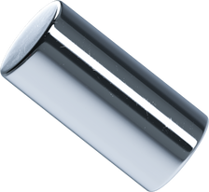



Our Service
REFURBISHING
ELECT. & MECH.
TROUBLESHOOTING
S.S FABRICATION WORKS
PROJECT
INSTALLATION
We specialize in refurbishing F.F.S. machines to restore optimal performance and extend lifespan, ensuring reliability and efficiency in your production processes.
Our qualified engineers provide expert electrical and mechanical troubleshooting services, delivering precise solutions to ensure optimal performance and resolve issues efficiently.
We offer high-quality stainless steel fabrication at competitive prices, combining professional craftsmanship with affordability. Trust us for reliable, top-notch results tailored to your needs.
We provide expert project installation services for new parenteral manufacturing units, ensuring seamless setup and compliance with industry standards. Our professional team delivers efficient, high-quality solutions tailored to your project's needs.

Slide 10

Business Strategy
STRATEGY 01
Innovation and Quality Focus: Our strategy emphasizes continuous innovation and superior quality in machine manufacturing. By investing in cutting-edge technology and R&D, we aim to develop advanced, reliable machines that meet evolving market demands. Rigorous quality control processes ensure high performance and durability, fostering customer satisfaction and long-term loyalty.
STRATEGY 02
Market Expansion and Customization: We plan to broaden our market reach through strategic partnerships and targeted marketing. Additionally, by offering customizable solutions tailored to specific industry needs, we enhance our appeal to diverse clientele. This approach not only drives revenue growth but also establishes us as a flexible and responsive industry leader.

Slide 11
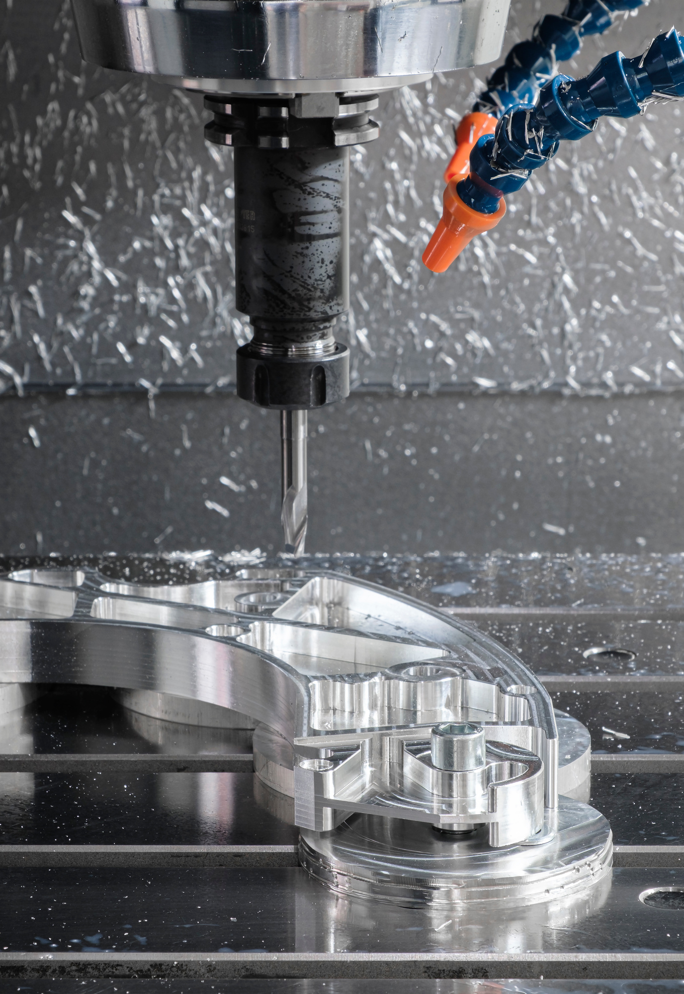
The Process
1
DESIGN AND ENGINEERING:
The machine manufacturing process begins with detailed design and engineering. Engineers and designers collaborate to create precise technical specifications and blueprints, incorporating advanced technology and materials. Prototypes are developed and tested to ensure functionality, safety, and performance standards are met before moving to production.
2
PRODUCTION AND ASSEMBLY:
Once the design is finalized, the production phase begins. This involves the fabrication of machine components using advanced machinery and techniques. Parts are manufactured, machined, and treated to exact specifications. Following fabrication, components are meticulously assembled into the final machine, with rigorous quality checks at each stage to ensure alignment with design specifications and operational reliability.
3
TESTING AND QUALITY ASSURANCE:
The assembled machines undergo comprehensive testing to validate performance, safety, and durability. Quality assurance procedures ensure that each machine meets industry standards and customer requirements. Final adjustments and calibrations are made before the machine is certified for delivery and deployment.

Slide 12

Benefits
BVM Industries' Form Fill Seal (F.F.S.) machines offer numerous advantages that enhance operational efficiency and product quality. Firstly, these machines provide high-speed, continuous production capabilities, significantly increasing output and reducing operational costs. The advanced automation features ensure precise filling and sealing, minimizing product wastage and maintaining consistent quality.
Additionally, BVM Industries' F.F.S. machines are designed for versatility, accommodating a wide range of packaging materials and formats, which allows for easy adaptation to diverse product requirements. Their robust construction and reliable performance reduce maintenance needs and downtime, ensuring uninterrupted production.
Moreover, these machines incorporate user-friendly interfaces and advanced control systems, facilitating ease of operation and quick setup. This results in a streamlined production process and enhanced overall productivity. BVM Industries' commitment to innovation and quality in F.F.S. machinery underscores their dedication to meeting the evolving needs of the packaging industry.

Slide 13
















Slide 14




Let's Connect With Us!
+91 70182 31499
bvmengineeringindustries@gmail.com
Baddi , himachal pradesh
At BVM ENGINEERING INDUSTRIES , our commitment to excellence drives us to deliver innovative solutions and superior quality. We continuously strive to exceed industry standards and client expectations, fostering growth and success. Partner with us to experience unparalleled expertise and dedication in every aspect of our service and products.

